Slide 1
Anti-plagiarism tools for our repositories
Jan Mach
University of Economics, Prague
Charles University in Prague
23. 10. 2013 Seminar on providing access to grey literature
Notes:
Images used: Slide 2: bravia2. Wallpaper “Ctrl C V” [online]. ZEDGE [quote 15. 9. 2013]. Available at WWW: http://www.zedge.net/wallpaper/5553887/ctrl-c-v/
Presentation background: Sielan. Copy paste keyboard : Computer keyboard with only three keys, ctrl, C and V for copy and paste [2012-11-15]. CanStockPhoto. Available at www: http://www.canstockphoto.com/copy-paste-keyboard-11603110.html. Image ID: csp11603110

Slide 2
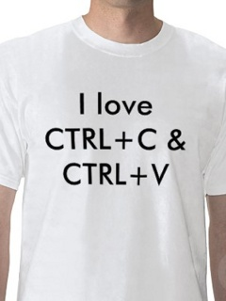
What is plagiarism?
clone – presenting another’s work, word-for-word, as one’s own
CTRL-C – presenting another’s work as one’s own, with minimum changes
find/replace – changing key words and phrases but retaining the essential content of the source
remix – paraphrasing from several sources into a single text
recycle – using an author’s previous texts, without citation
hybrid – mixing perfectly cited sources with non-cited ones
mashup – combining several non-cited sources into a text
error 404 – citations to non-existing sources or incorrect information about a source
aggregator – correct citation of foreign sources, but practically without any personal input by the author
re-tweet – correct citation, but using the original text/structure without significant changes
The Plagiarism Spectrum: Tagging 10 Types of Unoriginal Work
Notes:
Zdroj:

Slide 3
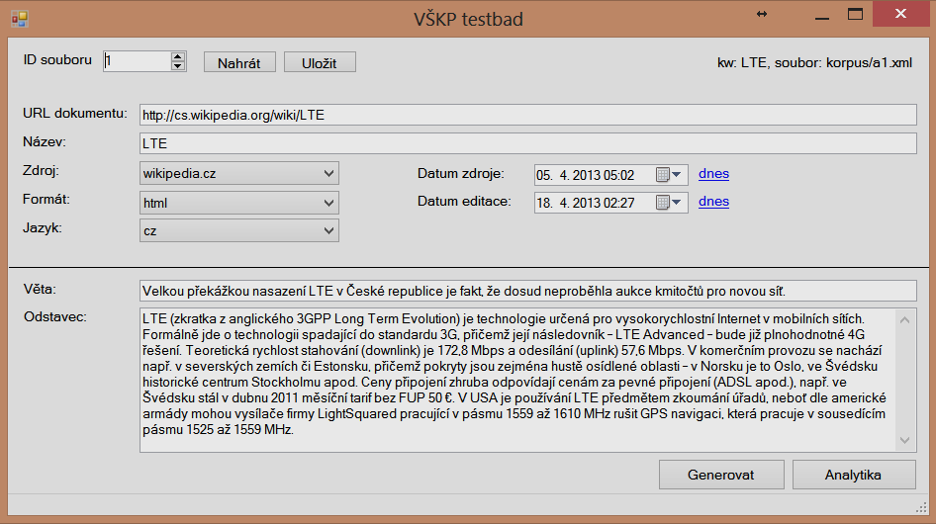
10 types of source from which students copy
a total of 50 documents, a sentence and paragraph from each
300 records – fragments of text using various changes to the copied sentences

Slide 4
Transformations used
a sentence with two words transposed,
a sentence with diacritics removed,
a sentence with a single word replaced with another with a similar meaning - paraphrasing a word,
a sentence with several words replaced with others with similar meanings - paraphrasing a sentence,
a sentence machine-translated into Czech/English

Slide 5
Hypotheses checked
The application is able to detect a single sentence copied from a source document.
The application is able to detect a single paragraph copied from a source document. The application is not affected by potential line breaks, indexes etc. in the source or tested document.
Successful detection is not impacted if the plagiarist adds/removes a word in the copied sentence.
The application can detect Czech texts irrespective of the use of diacritics.
Successful detection is not impacted if the plagiarist paraphrases a single word in a sentence.
Successful detection is not impacted if the plagiarist paraphrases a whole sentence.
Successful detection is not impacted if the plagiarist translates text from/to Czech.
The Theses.cz system should achieve the best results in the detection of plagiarism in Czech theses and dissertations.
A low percentage of the total number of similarities will be detected from the Anopress source compared to sources freely available on the internet.
Better results with EIR and Open Access sources are achieved by foreign tools rather than Czech ones.
Very good results for web sources will be achieved by systems using web search services.
Notes:
Hypoteza = Hypothesis
Prumer = Average

Slide 6
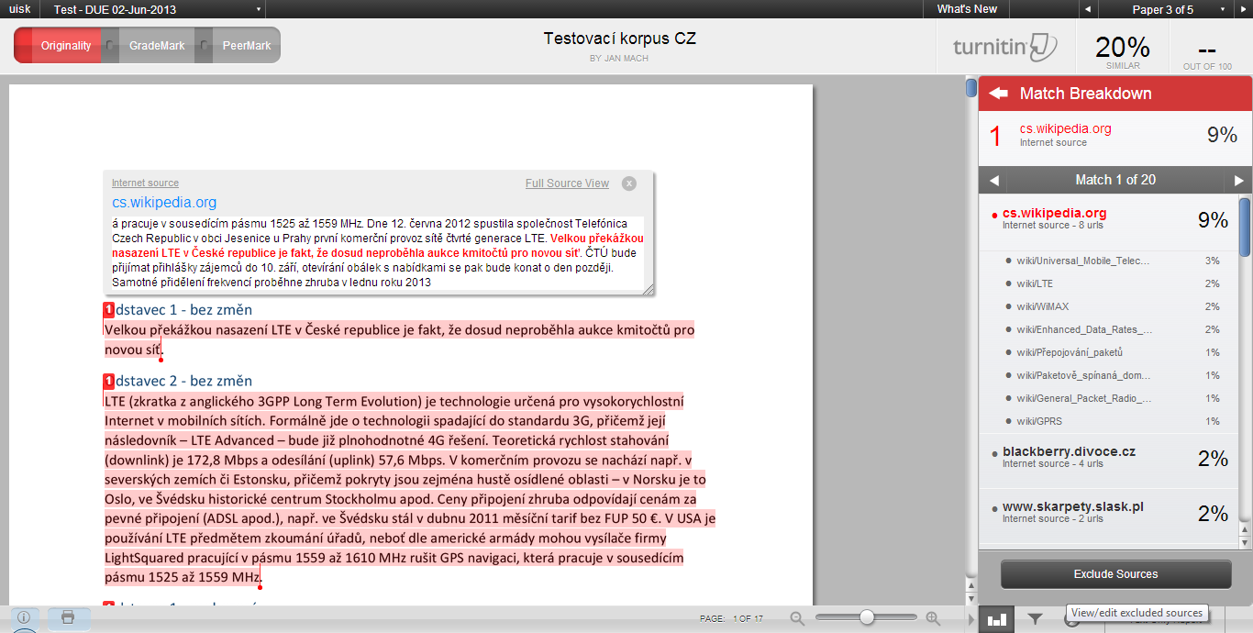
TURNITIN
ABOUT THE APPLICATION
EVALUATION OF SIMILARITIES
15 language variants without Czech
large database of texts
price based on number of students, hundreds of thousands of crowns
integration with MOODLE system and others, no API
GradeMark and PeerMark modules
processing within 30 s
configurable size of searched similarities, possibility to exclude citations
very clear and functional interface with similarities, association of sources

Slide 8
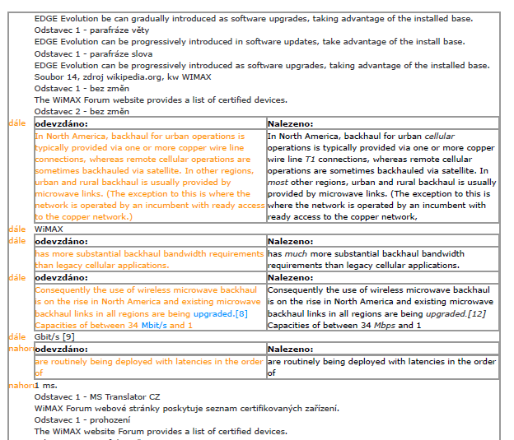
EPHORUS
ABOUT THE APPLICATION
EVALUATION OF SIMILARITIES
the application is used by over 3,000 schools and universities, 4 schools in the CR (Faculty of Business Administration at the University of Economics, Prague)
interface in Czech
operator claims a database with billions of web pages, submitted works, journal texts etc.
possible to define a min. similarity percentage
results sent by e-mail, attachments in PDF
basic web interface
no source de-duplication

Slide 10
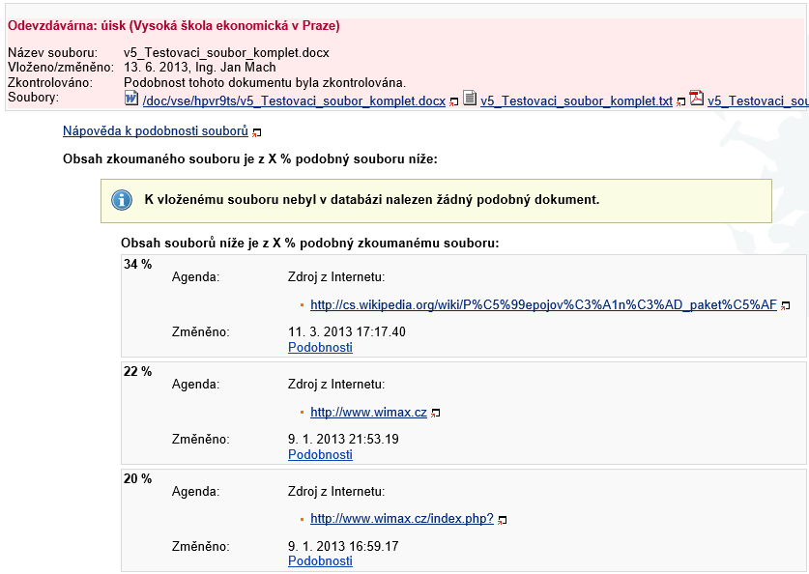
MUNI SYSTEMS
ABOUT THE APPLICATION
EVALUATION OF SIMILARITIES
theses.cz, odevzdej.cz and repozitar.cz
over 30 public and private schools in the CR and SR
price per number of students
extensive database of Czech theses and dissertations, study materials and selected web pages
API for connection
processing takes some hours
duplicate documents
comparing pairs of documents → two lists of similarities
no overall percentage of detected similarities
similarities displayed only from 5 % of the length of one of the compared document in a pair

Slide 11
The first list contains documents with similarity of min. 5 % of the inspected file.
bachelor paper with 40 pages: 2 pages
The second list complements the previous list with other documents, but only with the length of similarility min. 5 % of the found file.

Slide 12
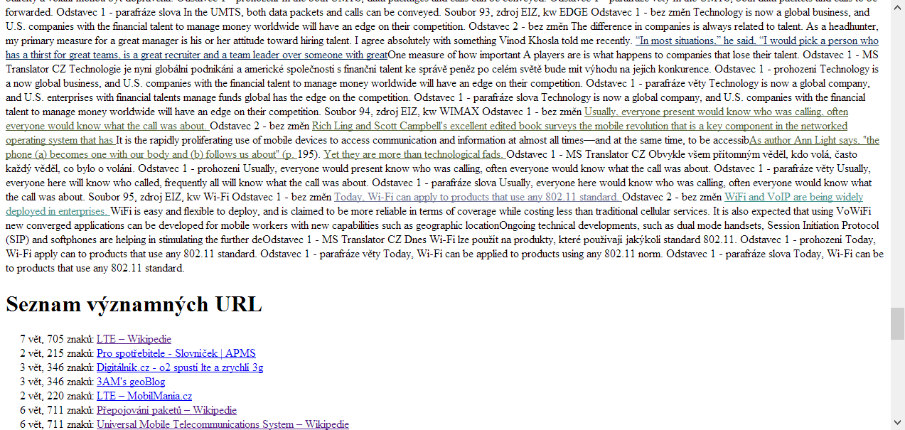
GooglePlagiarism
ABOUT THE APPLICATION
EVALUATION OF SIMILARITIES
my own desktop application for personal computers running Windows
intended for personal analysis of documents by an individual
searching for whole sentences in the Google search engine
limited number of searches→ processing takes several hours
HTML output without retaining formatting
highlighted detected sentences and the first corresponding source

Slide 13
Without retention of size and line breaks, navigation in a text during checks is much more difficult.
Notes:
[List of important URLs]

Slide 14
Evaluation of system control and function
The Thesis.cz system stands out thanks to its low price and possibility of repository integration.
The Turnitin application excels through its user interface and available functions, but is expensive and not easy to integrate.
The Ephorus system would be a good compromise between Thesis and Turnitin, yet …

Slide 15
Number of documents detected according to source
Low number of documents found using the Ephorus system.
Documents from Anopress were not detected by any system.
Most documents were detected by the Turnitin and GooglePlagiarism systems.

Slide 16
Number of documents detected according to document language
The Theses.cz system detected an average number of Czech documents, but posted the worst results for English documents.
Still, however, more than Ephorus overall. A reduction in the 5% limit would significantly enhance the success rate of Theses.cz!

Slide 17
Number of records detected according to type of change – suspicion of plagiarism
Searching for whole sentences in the GooglePlagiarism application does not detect text changes.
The Ephorus system detected only 8 similar passages in the text, however these were mainly transcriptions of abbreviations.

Slide 18
Number of detected records according to type of change – proof of plagiarism
The Ephorus system actually detected only one document clearly showing plagiarism.
As yet none of the systems is able to search for a translated text.
GooglePlagiarism best detects sentences without changes, while Turnitin best detects sentences with changes.

Slide 19
Final summary
The Turnitin application achieves very good results, but is very expensive.
The Ephorus application is inadequate at detecting duplicates in the text corpus.
The Theses.cz application is a good compromise between price and capability. Removing the 5% limit on similarity detection would help.
Searching for sources online in GooglePlagiarism is very effective at detecting copied texts.

Slide 20
You can find detailed test results in the proceedings of the Seminar on providing access to grey literature 2013
http://nrgl.techlib.cz/index.php/Workshop
Jan Mach
machj@vse.cz

